Slide 1
Urban Forest Management Plan Grant Program
June 20, 2012
Inland Urban Forest Council
San Rafael, CA
Workshop Three
Funded by: US Forest Service & Cal Fire

Slide 2
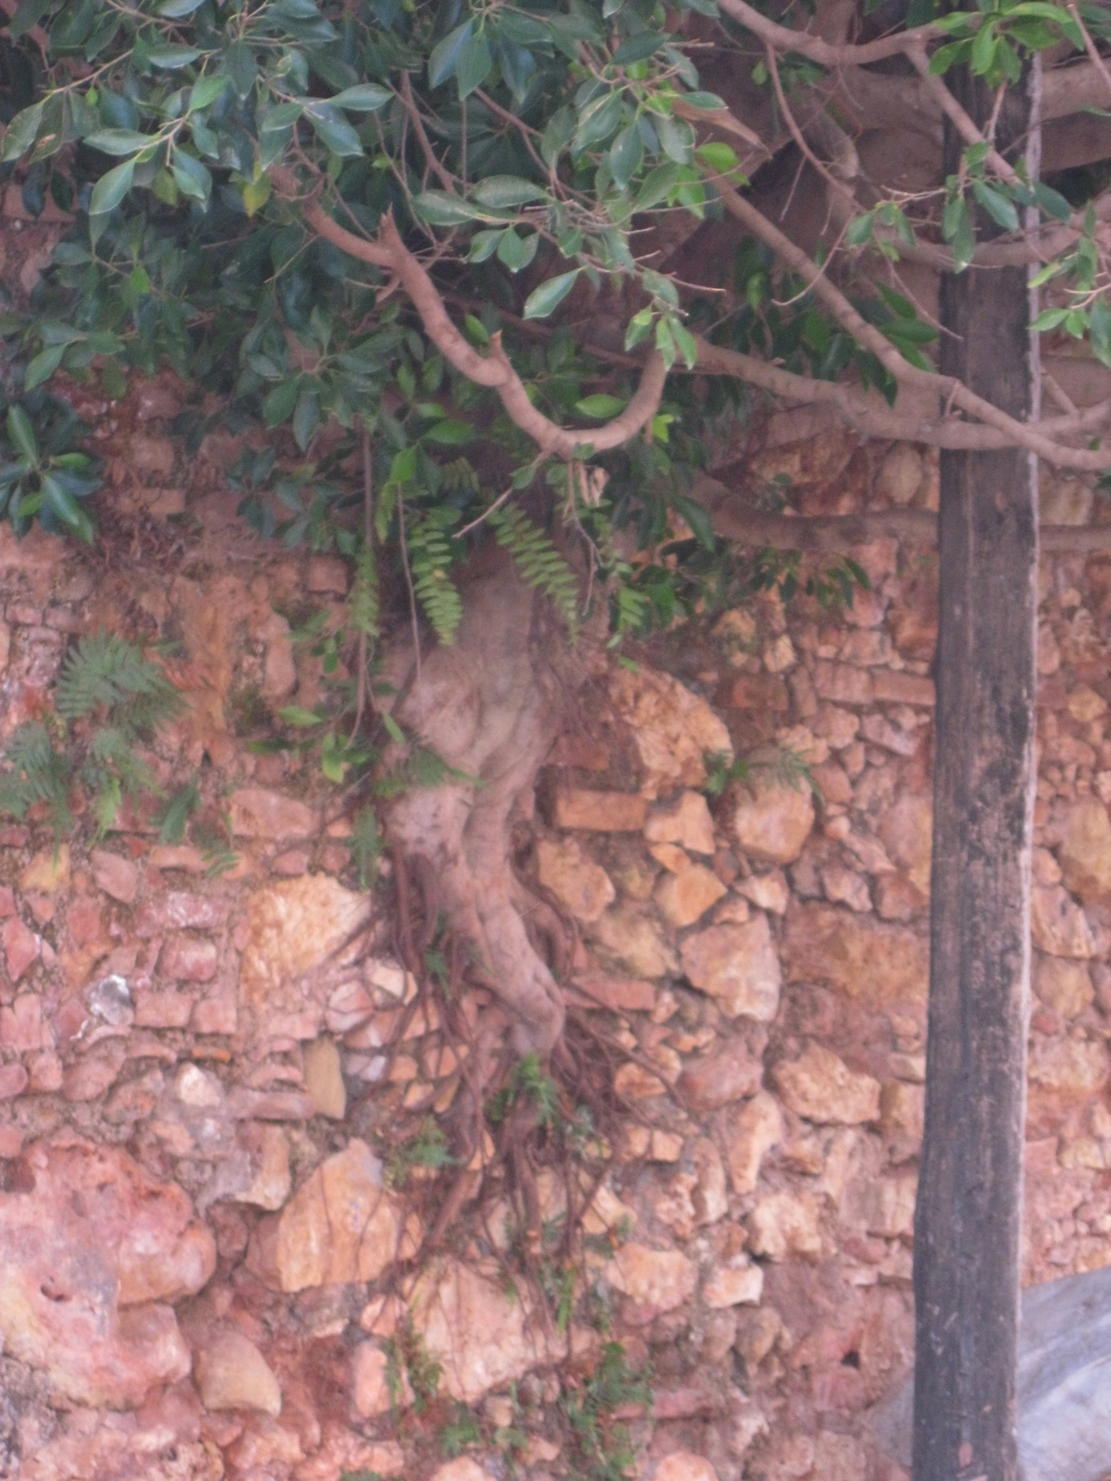
Welcome!!!

Slide 3
Today’s Agenda
9:00 – 9:30 - Overview of i-Tree
10:00 – 10:30 - Vision and Mission Discussion
10:30 – 10:45 Break
10:45 – 11:45 - Goals & Objectives (Breakout Session)
11:45 – 12:30 Lunch
12:30 – 1:45 - How to Engage Others in Your Mission
Guest Speaker: Tracy Thomas
1:45 – 2:30 – How do you get what you want?

Slide 4
Follow Up – Canopy Cover
Hello Nancy,
Sorry for the delay on answering your question. The formula is for quickly estimating the maximum street tree canopy cover possible. Assume that every street is a boulevard with a continuous row of trees planted down the middle and the crowns just touch each other and they completely cover the roadway. Then this area would simply be the total length of streets in the community multiplied by the average street width. So essentially what you have is the total area of street pavement.

Slide 5
Canopy Cover Formula
Now assume that instead of a boulevard with a single row of trees down the middle you have two rows of trees – one on either side of the street, which is more common. So double your original estimate and now you have the estimated maximum canopy cover for street trees. This assumes that every street is lined with mature trees.

Slide 6
Canopy Cover Formula con’t
Is this reasonable? Certainly not, but it gives you the upper most theoretical limit and you can work backwards from there. Many cities have street tree inventories that include a count of vacant plantable spaces. So this can give you an idea of what percentage needs to be deducted from the theoretical maximum. But you also have to account for the fact that not all streets have plantable spaces, particularly under utility lines. So use this estimator for what it’s worth – a starting point.
I hope this helps.
R.J.

Slide 7
I Tree

Slide 8
Vision & Mission Examples

Slide 9
Vision and Mission
Vision - It is a written statement describing the big picture.
Mission is more a statement of purpose.

Slide 10
Examples of Vision Statements
To have a city rich with park environments and streetscapes that foster awareness of the values that trees provide, where the public is conscious of and appreciative of its urban forest, its merit, and the broad range of benefits it provides to the city’s constituency.

Slide 11
Vision
Chico’s forest provides coverage and shade over a large area of the city creating a continuous forest canopy. This canopy contains trees of all sizes at maturity, is multi-aged and diverse. The forest is healthy and safe, with appropriate tree species planted in appropriate locations and in ideal cultural conditions. Citizens are active partners in our program and they want their trees and forest to be thriving and understand their role in accomplishing this. The standard of care for the forest is based on accepted industry standards and the concept of enhancing the longevity of the trees within the forest. All city staff and officials are knowledgeable about the urban forest management plan and use it as a guideline in deliberation regarding project planning and design.

Slide 12
Vision
The city of Davis will be a community dedicated to a thriving and sustainable urban forest. Relying on the community forest management plan for guidance, the city of Davis will actively encourage participation in tree planting and stewardship, preserve and protect existing trees, promote public safety and tree health. Also by implementing cost-effective enhancement and maintenance practices of the forest and increasing public awareness of the value of our community forest, the city of Davis will maximize the social, economic and environmental benefits of the community forest for current residents and future generations.

Slide 13
Vision
SFSU manages an urban forest with a sustainable optimum tree canopy to provide the desired screening, shade, soil retention, and sun areas in a risk-conscious environment.

Slide 14
Examples of Mission Statements
The mission of the facilities division is to promote a healthy and sustainable urban forest so as to enhance the beauty and prosperity of the community.

Slide 15
Mission
Our mission is to enhance the quality of the academic, living and working environment at Pt. Loma Nazarene University by promoting the benefits of trees and maintaining a sustainable urban forest through best management practices, collaboration and education.

Slide 16
Mission
The mission of the public works department’s lighting and landscaping division is to maintain the current urban forest of 1,700 public trees in as sustainable, cost effective manner following current best management practices and to enhance Dixon’s urban forest by planting additional trees when possible and as needed.

Slide 17
Mission
Our purpose is to maintain, enrich and promote the urban forest from trees to shrubs to lawns to raised vegetable beds. This is a dynamic, sustainable city with constant flux of seasons and weather, natural disasters and man-made problems.

Slide 18
Mission
Our mission is to preserve the existing urban forest while developing it to be stronger, healthier, and more diverse. By actively educating the public, developing short and long term goals, identifying problems, we are creating an urban environment that maximizes positive environmental and social impacts, aesthetics, and promotes an increased quality of life for the residents of Fontana.

Slide 19
Break

Slide 20
Goals and Objectives

Slide 21
Definitions
Goals ‘“ are long-term aims that you want to accomplish.
Objectives ‘“ are concrete attainments that can be achieved by following a certain number of steps.

Slide 22
Examples

Slide 23
Goals of Master Plan West Hollywood
Short Term
Updated Urban Forest Inventory
Updated Streetscape Master Plan (Roma Plan)
Canopy cover 1984 vs. 2012 estimates
Determine Value of Urban Forest…, financial, social, cultural
Long Term
Community Education
Increase Diversity of Species
Address issues with maturation of Urban Forest

Slide 24
Goals for the UFMP Point Loma
Establish long range plan for selecting, planting, removal, and replacement of campus trees.
Maintain health and diversity of the campus forest.
Protect Heritage Trees
Demonstrate the value of campus trees environmentally, physically and aesthetically.

Slide 25
Three Main Goals Santa Clara Valley Water District
To quantify canopy cover and carbon sequestration in order that we can calculate the value of canopy cover in our urban forest project.
Relate the value of trees on our urban forest project to the district leadership and decision makers in order that we can significantly increase funding for tree planting and maintenance.
To integrate as a part of the District’s Greenhouse Gas Emission Reduction Program by calculating carbon sequestration using the canopy coverage method and incorporate trees as an integral part of the District Climate Action Planning.

Slide 26
Goals – Tangible and Quantifiable
If you are explicit in stating your goals (e.g., attain 35 % canopy cover by the year 2020), it will be easier to evaluate your progress toward your goals. If you state goals more generally (e.g., improve level of tree care on commercial properties), you may want to set specific benchmarks to indicate how success will be measured

Slide 27
Objectives
Objectives provide more specificity by breaking goals into the components that make up each goal. Like goals, objectives are desired outcomes, but are more specific and limited in scope.

Slide 28
In Summary
The combination of goals and objectives spell out what you want for your urban forest. They describe your desired destinations. How you get to those destinations, by using specific actions and tools.

Slide 29
Group Exercise
Break into groups of four
Look at provided goals
Discuss and formulate Objectives

Slide 30
Lunch

Slide 31
How to Engage Others in Your Mission
Guest Speaker: Tracy Thomas

Slide 32
How do we get what we want?
Consider and select actions and tools to achieve your goals and objectives.
Notes:
In this step, you will consider and select actions and tools to achieve your goals and objectives.

Slide 33
Action
An action is something you do to achieve an outcome - e.g. plant trees, conduct workshops, or enforce regulations.

Slide 34
Tools
Tools are things you use to help you take an action. For example, a tree inventory is a tool that can be used to help schedule maintenance, manage tree hazards, identify planting spots etc.

Slide 35
Tools & Actions
Appropriate tools and actions will vary with the overall target (tree resources, management, community)
And whether management is direct (e.g., maintenance of trees that you manage) or indirect (e.g., improve tree planting practices used by contractors or the public).

Slide 36
Actions to Specific Steps
A single action may actually require a number of specific steps.
For example implementing a Citizen Forester Program.

Slide 37
Citizen Forester Program
Who is going to run the program.
Outline the roles & duties of the Citizen Forester.
Define training that they are going to receive.
Put together the training materials.
Print materials.
How many, where, when for workshops.
Measure what the Citizen Foresters have learned.
Measure impact of program.

Slide 38
Action to Specific Steps
Many courses of action.
Compare the feasibility, cost, and effectiveness of alternative actions.
Notes:
Before choosing a given action, you should consider the steps that will be needed to implement it. This will help you compare the feasibility, cost, and effectiveness of alternative actions.

Slide 39
How much detail?
Strategic Plans
Implementation Plans
Work plans

Slide 40
Strategic Plans
More General
Needs approval of City Council or Upper Management
Citizen Forester Program outline duties and responsibilities etc.
Do not list individual steps.
Notes:
At the strategic plan level, you won't list the individual steps related to each action. The strategic plan is typically subject to approval by a city council or upper management.
If the action section of the strategic plan is overly detailed, any small change might require council or management approval.

Slide 41
Implementation Plan
Details of executing actions, including personnel, timing, and budgeting are commonly placed in an implementation plan, which may be developed as a separate document.
Implementation plans are typically reviewed and revised more frequently than strategic plans. Revisions are typically done at staff level.

Slide 42
Work Plans
The level of detail in a plan can be increased to the point that it addresses the management of specific trees - this is a work plan.

Slide 43
Work Plans
Work plans are more subject to change and may need to be updated multiple times in a given year..
Work plans may be included as addenda or supplements to the overall plan, but are more commonly included only by reference.
Notes:
For instance, the strategic plan may specify that work plans will be developed to assist in short-term planning.

Slide 44
Linkage
Implementation and Work Plans are really extensions of the strategic plan rather than a distinct type of plan.

Slide 45
Linkage
At every level of detail, actions should support the overall goals and objectives of the management plan.
If your management plan is comprehensive, every action specified at the work plan level should show a connection to management plan goals.

Slide 46
Develop an implementation plan
The implementation plan is where you describe how your actions will be carried out.
For each action, the implementation plan spells out:
Notes:
The management plan sets goals and objectives, which provide the overall destinations of the plan. It also lists actions needed to accomplish the goals and objectives.

Slide 47
Implementation plan spells out the following:
Priority Ranking
Funding
Specific annual budget
Identify personnel responsible for it
Time Schedule

Slide 48
Priority Ranking
Overall plan has prioritized goals and objectives.
Implementation Plan reviews these and adjusts for shorter planning intervals.
Budget constraints will impact priorities and shorter planning intervals.

Slide 49
Priority Rankings
Priority rankings are also used to phase activities over time so that high priority tasks are completed before low priority tasks.

Slide 50
Identify funding
If funds are inadequate for your new plan, your plan should include the goal of developing suitable sources of funding.
Grant funding may be appropriate for one-time or infrequent expenses such as developing educational handouts.
Ongoing activities, such as tree care and maintaining the tree inventory, will need a stable source of funding.
Notes:
In your review of the management program, you identified existing sources of funding used by your program.

Slide 51
Develop budgets
Budgeting each goal, objective, and specific plan takes time and a good deal of thought.
Personnel
Materials & Supplies
Equipment
Contract Services

Slide 52
Assign responsibilities
The implementation plan should indicate who is going to carry out the actions described in the management plan.
This includes administrative responsibilities as well as the work units or staff positions that will actually conduct the work.
Notes:
You may already have developed this information in order to develop budget estimates.

Slide 53
Establish timelines and priorities
The implementation plan should include realistic timelines for conducting actions and meeting objectives.
Some activities need to be completed in a given order.
If steps are handled by different units or departments, schedules have to be shared to coordinate the phasing of activities.
Regular status updates can indicate whether the schedule needs to be revised.

Slide 54
Review
Vision is that future picture.
Mission is implementation of vision, what you do, how you do it, why you do it and for whom you do it.
Goals are your long term aims as to what you want to accomplish.
Objectives are the steps to achieving the goals.
An action is something you do to achieve an outcome.

Slide 55
Review
Tools are things you use to help you take an action.
Strategic Plans are how you get what you want.
Implementation Plans are details of executing actions, including personnel, timing, and budgeting.
Work Plans are specific details.

Slide 56
Carbon Offsets & the Urban Forest
http://ccuh.ucdavis.edu/events/carbon-offsets-the-urban-forest-1/carbon-offsets.

Slide 57
What is Next & Assignments
Develop your strategic, implementation and work plans over the summer.

